Slide 1


Core Principles of Programming with python
Week 1

Slide 2

Installing Python 3
https://www.python.org/downloads/windows/

Slide 3
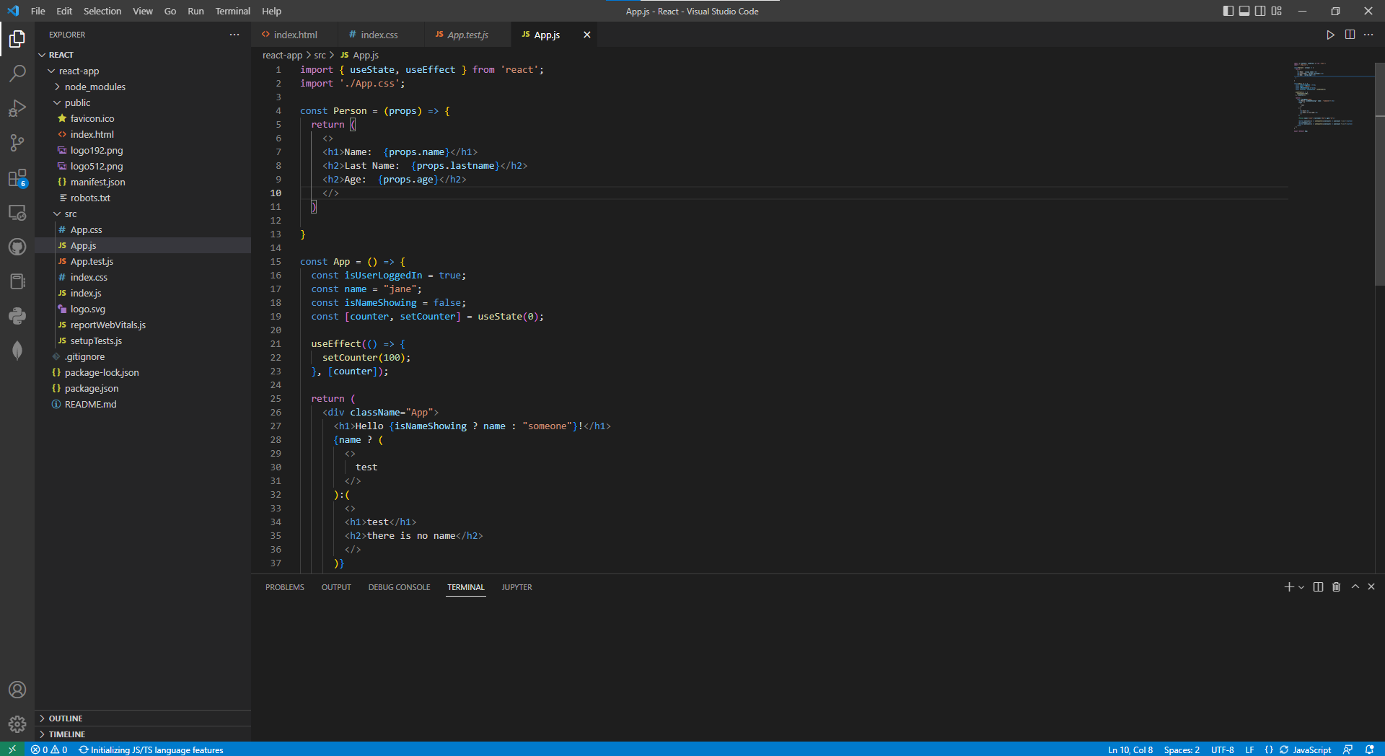
Installing VSCODe
https://code.visualstudio.com

Slide 4
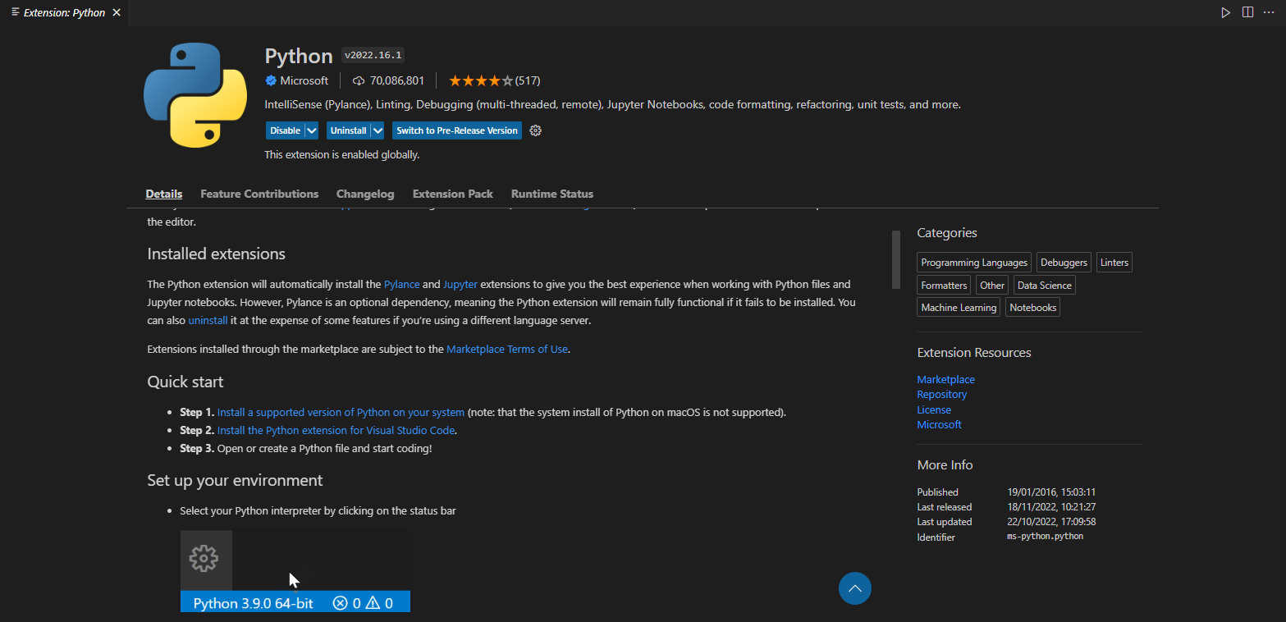
Installing Python Extension

Slide 5
Setting up the workspace
Create a folder called “Computing Society”.
Click “open folder” and press that folder.
The standard naming convention for the main file is “main.py”.
Create that file.

Slide 6
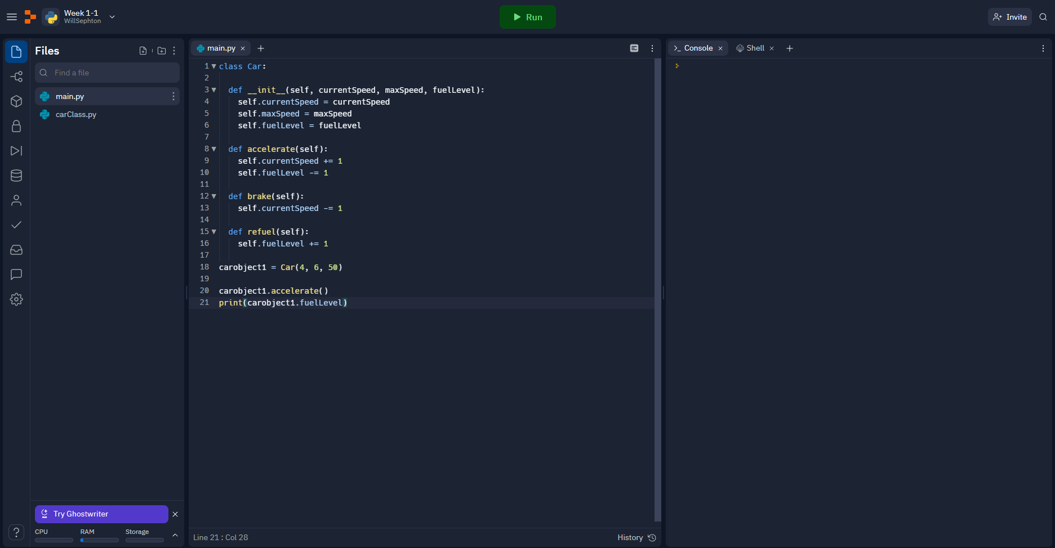
Online alternatives
There are several online IDE’s but the most commonly used one is:
Repl.it

Slide 7

Variables
An example of a variable in Python:
Var1
This variable is containing a “String”.
Variables are like boxes.
You name the box and then you place content into it.

Slide 8

Variable Data Types
An example of the data types in Python:
String:
Integer:
Boolean:
There are 3 important data types.
Strings are for text.
Integers are for numbers.
Booleans are specifically “True or False”.

Slide 9

Using the print() Command
An example of the data types and a print function in Python:
The print() command is how you print to the console.
You can print using the variable or by typing your own string in the brackets.
Item you would like to print
Print command

Slide 10
Activity
Further Activity
Add two numbers together and then print the resulting value.
Using what you have just learnt,
Store the string “Hello World” in a variable,
And then print that variable to the console.

Slide 11

Using the input() Command
An example of the input command in Python:
The input() command is how you get the user to input a value into a variable.
Remember the input function will record whatever you enter as a string. You will need to convert the string into an integer if you want to compare the inputted value.
What will be displayed to the user before they are able to input something
Variable Name
Input command

Slide 12
Activity
Convert String to Integer
To convert a string into an integer you must use:
variable name = int(variable name).
Edit your previous code to have the user input two numbers, store them in different variables and then add them together.
Then print the value of the result into the console.

Slide 13
End of week one

